Slide 1
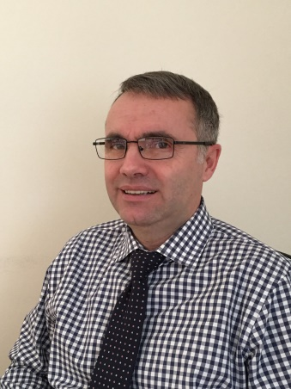


World Registry of New Ideas
  www.worldnewideas.com
  Jerry Comanescu, Ph.D.-Esq.
  (Physicist & Intellectual Property Attorney)
  Digital-age ALTERNATIVE to Academic Journals & Patents
  Paradigm Shift:
  FUNDAMENTAL CHANGE in the way scientists and innovators
  protect their IDEAS & DISCOVERIES
presented at:
http://connectpreneur.org/
"Number One" tech and investor event in the Mid-Atlantic region!
BigIdea
CONNECTpreneur

Slide 2
World Registry of New Ideas
  www.worldnewideas.com
COMPLETEY NEW type of online service, based on three NOVEL CONCEPTS:
  Registration of Ideas
  Priority-Claims
  Priority-Certificates
  (recently disclosed by "Oxford Journal of Intellectual Property“)
At maturity (5-10 years) the service can:
  reach 200 million users worldwide
  bring $2 billion - $5 billion per year in revenue (high profit margin)
ENDURING type of business … 50 YEARS or longer (similar to Academic Institutions)

Slide 3
… for more than 200 years
scientists have used only TWO types of documents
to protect ideas & discoveries:
Journal
Articles
Patents
Deficiencies & Limitations:
Academic Journals
slow, cumbersome and ineffective (takes MONTHS / LOTS OF RESOURCES to write an article)
BIASED against the LESS-INFLUENTIAL scientists & innovators
Patents
very expensive … intrusive forms of IP (i.e. interfere with ECONOMIC FREEDOM)
the wide majority of ideas & discoveries are NON-PATENTABLE (i.e. cannot be protected by patents or any form of IP)

Slide 4
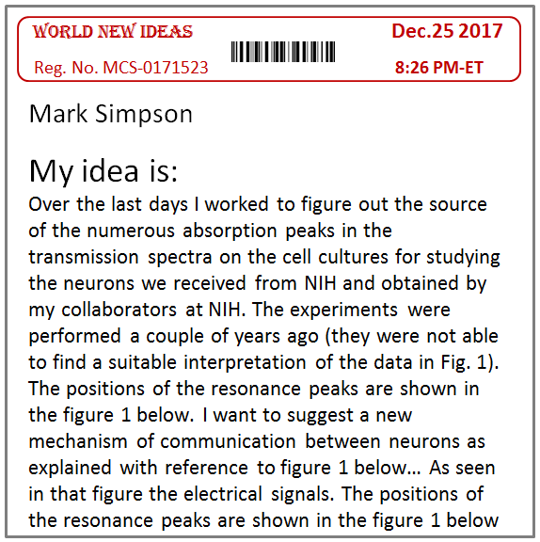
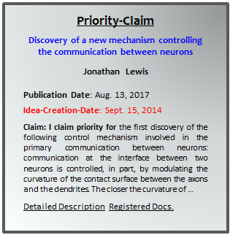
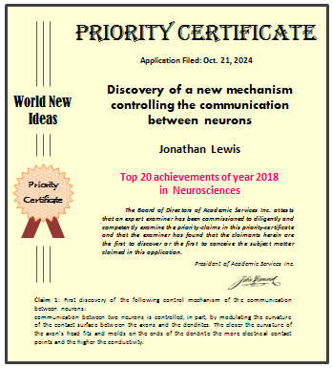
articles published by Oxford Journal of Intellectual Property* & IP Today introduce:
Three NEW FORMS of IP / Documents
(non-intrusive forms of IP)*
Registered
Priority-Document
Formal Priority-Claims
Priority-Certificates
Mitigating Deficiencies of Academic Journals & Patents
Particularly useful for NON-PATENTABLE ideas & discoveries
Can be used either as an ALTERNATIVE or IN-ADDITION to publication in Journals
*Priority-Certificates, a proposal for non-intrusive forms of IP; by Comanescu & Hyndman
Oxford Journal of Intellectual Property, (May 2015, Vol. 10, No. 6)

Slide 5
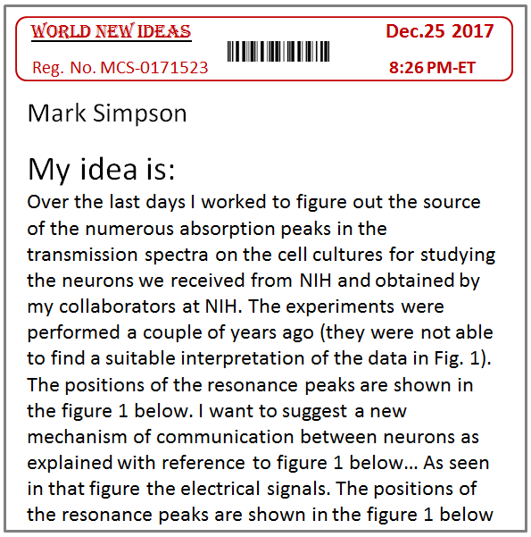
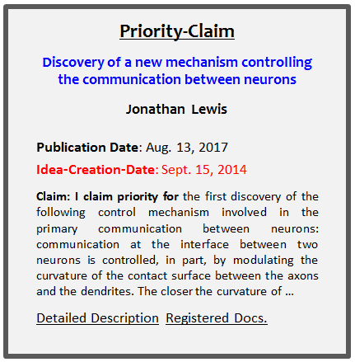
10-15 years from now:
we expect about 20 million of such documents issued per year
(more than all Journal Articles & Patents together!)
Grantors:
Google
Facebook
LexisNexis
LinkedIn
…
Stanford
MIT
The GRANTOR of such documents will receive significant benefits:
Financial Benefits: 20 million documents → revenue of up to $5 billion per year (100 million users)
Reputational Benefits: acting as Academic Authority and Dispute Resolution Authority for scientific, intellectual & academic priority disputes (enduring type of business … 50 YEARS or longer)

Slide 6
The problem of multi-party projects
Scientific & Medical Achievements
(e.g. Discovery … New Medical Procedure … New Technology … New Device)
3-5 years project … 20 contributors … 3 institutions
many contributions (e.g. ideas, discoveries, algorithms, experiments, software)
Anne
Peter
John
Chen
Linda
Mark
. . .
Questions: Career Consequences:
Anne’s Contribution? → … Article co-Author? … Inventor? … Tenure? … Prize?
Peter’s Contribution? → … Article co-Author? … Inventor? … Tenure? … Prize?
… …
Mark’s Contribution? → … Article co-Author? … Inventor? … Tenure? … Prize?
Registry System provides ANSWERS to the QUESTIONS above
… Mark, Anne, Peter secure CREDIT & RECOGNITION for their contributions

Slide 7
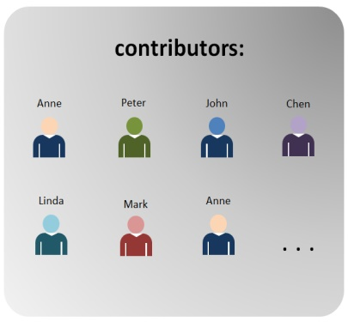
Biology Department of University
Professors: Peter & Bill
Students: Mark, Chen, Vera, John, Anne, …
The problem of multi-author Articles:
Story of Article:
idea-1: Peter (Oct. 7, 2012)
Grant proposal … research funding
discussions … equipment purchase …
idea-2: Mark (Feb. 5, 2014)
4 years
Experiment-1: Chen (Aug. 1, 2014)
Journal Article includes:
MULTITUDE of ideas & discoveries (20 pages)
conceived by many people (10 co-authors)
over a LONG TIME (3-5 years!)
insight-1: Vera (Apr. 2, 2015)
idea-9: John (Jan. 3, 2016)
Article date: Nov. 8, 2016
10 co-authors:
John, Anne, Mark, Peter, Chen … Bill

Slide 8
Biology Department of University
Professors: Peter & Bill
Students: Mark, Chen, Vera, John, Anne, …
The problem of multi-author Articles
… 10 co-authors
Story of Article:
idea-1: Peter (Oct. 7, 2012)
Article does NOT say that:
  Peter came up with idea-1
  Mark came up with idea-2
  Chen performed experiment-1
    …
  Vera came up with insight-1
Grant proposal … research funding
discussions … equipment purchase …
idea-2: Mark (Feb. 5, 2014)
4 years
Experiment-1: Chen (Aug. 1, 2014)
insight-1: Vera (Apr. 2, 2015)
idea-9: John (Jan. 3, 2016)
Article is 20 pages long:
… Mark’s idea is BURIED among 20 pages of info and nobody knows that Mark is the actual creator of idea-2 (the most important in the article)
… public assumes that Bill, the most recognizable name, created the most important ideas in the article
Article date: Nov. 8, 2016
10 co-authors:
John, Anne, Mark, Peter, Chen … Bill

Slide 9
Story of Article:
4 years … 15 collaborators … 3 institutions
The problem of multi-idea Articles:
idea-1: Peter (Oct. 7, 2012)
idea-2: Mark (Feb. 5, 2014)
Article does NOT say that:
… Idea-1 was created on Oct. 7 2012
… Idea-2 was created on Feb. 5 2014
  …
… Idea-9 was created on Jan. 3 2016
Earliest date on article: Nov. 8 2016
Experiment-1: Chen (Aug. 1, 2014)
4 years
2 years
Unsecured Idea
insight-1: Vera (Apr. 2, 2015)
idea-9: John (Jan. 3, 2016)
Article date: Nov. 8, 2016
10 co-authors:
John, Anne, Mark, Peter, Chen … Bill
unsecured period
Idea-1 created in Oct. 2012 – article date Nov. 8, 2016 → LOST 4 years of priority
Idea-2 created in Feb. 2014 – article date Nov. 8, 2016 → LOST 2 years of priority
…
Idea-9 created in Jan. 2016 – article date Nov. 8, 2016 → LOST 8 months of priority

Slide 10
Story of Article:
4 years … 15 collaborators … 3 institutions
Mark’s Situation
Disclosing his idea to advisor & colleagues is RISKY … they can tell him “I knew about this idea long ago”
idea-1: Peter (Oct. 7, 2012)
idea-2: Mark (Feb. 5, 2014)
Experiment-1: Chen (Aug. 1, 2014)
Feb. 2014 -- Nov. 2016
Mark’s idea is unsecured
“Word Spreads” about Mark’s idea …
4 years
2 years
Unsecured Idea
insight-1: Vera (Apr. 2, 2015)
idea-9: John (Jan. 3, 2016)
Article date: Nov. 8, 2016
10 co-authors:
John, Anne, Mark, Peter, Chen … Bill
Other RISKS:
Mark lives with the fear & uncertainty that others may publish the idea before him
Mark is not even sure that an article will be published … or that he will be on the article …

Slide 11
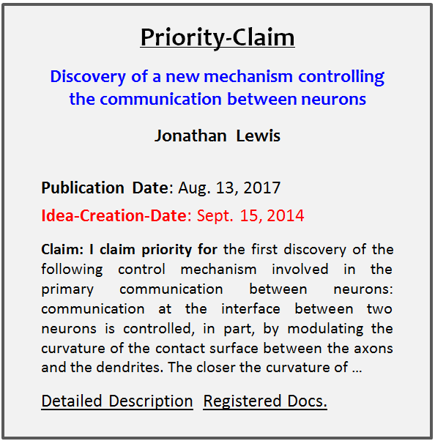
Without the Registry
World Registry of New Ideas
4 years … 15 collaborators … 3 institutions
Three
New FORMS of IP
Three
LEVELS of OWNERSHIP
idea-1: Peter (Oct. 7, 2012)
20 mins
Registration of Idea
(Private)
Idea-Creation-Date: Feb. 5, 2014
idea-2: idea for a novel experiment …
Mark, actual-date: Feb. 5, 2014
Experiment: Chen (Aug. 1, 2014)
4 years
0 to 3 years
Publication
Dec. 4, 2016
Unsecured Time (2 years)
REGISTRY eliminates
Priority-Claims
(Public)
Idea-Creation-Date: Feb. 5, 2014
insight: Vera (Apr. 2, 2015)
idea-9: John (Jan. 3, 2016)
Article date: Nov. 8, 2016
10 co-authors:
John, Anne, Mark, Peter, Chen … Bill
2 to 5 years
Jan. 8, 2021
Priority-Certificates
(Formal Examination)
Idea-Creation-Date: Feb. 5, 2014
Mark, Peter, Chen, Vera … John
secure CREDIT & RECOGNITION
for their Individual Contributions & Ideas to the Article!!

Slide 12
  STEP-1:
  Registration of Ideas & Discoveries
Username
  Dec. 25, 2017
  Mark comes up with an IDEA
  20 minutes later:
  Mark writes the idea in a document and uploads it on his registration account:
MSimpson84
Idea-Registration
Accounts
Password
*********
Sign-in
Registration-Account
Mark C. Simpson
Sign Off
PRIVATE & CONFIDENTIAL
USER RECORDS
Registered Documents
 | Registered Documents | Date & Time Created
1 | Document-21 | 12/25/2017
2 | Document-20 | 01/21/2017
3 | Voice-3 | 12/26/2016
4 | VideoRecord-5 | 12/24/2016
5 | Document-19 | 12/20/2016
6 | Document-18 | 11/19/2016
7 | Voice-2 | 10/25/2016
8 | Voice-1 | 10/15/2016
Mark Simpson Dec. 25 2017
My idea is:
Over the last days I worked to figure out the source of the numerous absorption peaks in the transmission spectra on the cell cultures for studying the neurons we received from NIH and obtained by my collaborators at NIH. The experiments were performed a couple of years ago (they were not able to find a suitable interpretation of the data in Fig. 1). The positions of the resonance peaks are shown in the figure 1 below. I want to suggest a new mechanism of communication between neurons as explained with reference to figure 1 below… As seen in that figure the electrical signals. The positions of the resonance peaks are shown in the figure 1 below the resonance peaks are shown in the figure 1 below
Browse
Upload
  We assume the role of:
  Impartial Record Keeper & Legally-Bound Witness

Slide 13


Username
MSimpson84
Idea-Registration
Accounts
Password
*********
Sign-in
Registration-Account
Mark C. Simpson
Sign Off
PRIVATE & CONFIDENTIAL
Registration & Time Stamp
USER RECORDS
Registered Documents
  Registered Priority Document:
  (OFFICIAL RECORD)
  … created within 20 minutes from conception
  … idea-creation-date printed on document
World New Ideas Dec.25 2017
Reg. No. MCS-0171523 8:26 PM-ET
Mark Simpson Dec. 25 2017
My idea is:
Over the last days I worked to figure out the source of the numerous absorption peaks in the transmission spectra on the cell cultures for studying the neurons we received from NIH and obtained by my collaborators at NIH. The experiments were performed a couple of years ago (they were not able to find a suitable interpretation of the data in Fig. 1). The positions of the resonance peaks are shown in the figure 1 below. I want to suggest a new mechanism of communication between neurons as explained with reference to figure 1 below… As seen in that figure the electrical signals. The positions of the resonance peaks are shown in the figure 1 below
 | Registered Documents | Date & Time Created
1 | Document-21 | 12/25/2017
2 | Document-20 | 01/21/2017
3 | Voice-3 | 12/26/2016
4 | VideoRecord-5 | 12/24/2016
5 | Document-19 | 12/20/2016
6 | Document-18 | 11/19/2016
7 | Voice-2 | 10/25/2016
8 | Voice-1 | 10/15/2016
  Independent Administrator
PRIVATE document
users secure strong evidence
(without aggravating collaborators & manager)
Browse
Upload

Slide 14
  Registered-Documents
  character & feel of OFFICIAL RECORDS
  Administrator is LEGALLY BOUND to follow RIGOROUS PROCESS
  High SECURITY / RELIABILITY / CONFIDENTIALITY standards, via safeguards ensuring that:
    Virtually impossible to LOSE documents
    Virtually impossible to FALSIFY documents (employing “System for verifying AUTHENTICITY of documents”)
    Documents are kept for as long as needed (e.g. 50 years!)
  FAIR, UNIFORM and IMPARTIAL (equal treatment of users)
Registration & Time Stamp
World New Ideas Dec.25 2017
Reg. No. MCS-0171523 8:26 PM-ET
Mark Simpson Dec. 25 2017
My idea is:
Over the last days I worked to figure out the source of the numerous absorption peaks in transmission spectra on the cell cultures for studying the neurons we received from NIH and obtained by my collaborators at NIH. The experiments were performed a couple of years ago (they were not able to find a suitable interpretation of the data in Fig. 1). The positions of the resonance peaks are shown in the figure 1 below. I want to suggest a new mechanism of communication between neurons as explained with reference to figure 1 below… As seen in that figure the electrical signals. The positions of the resonance peaks are shown in the figure 1 below
Official Record
( PRIVATE )
Public Perception: public would recognize documents as “Highly Credible & Authoritative”
(similar to Official Documents)
Strong Evidentiary Value: physical evidence created by UNIFORM and SECURE process

Slide 15
The GRANTOR of Registered Documents
The VALUE & PUBLIC-DEMAND for registered documents would be higher if granted by prestigious organization such as: Google, Facebook, LinkedIn, Stanford, MIT, Princeton …
Google
LinkedIn
Facebook
LexisNexis
Harvard
MIT
Stanford
…
Google New Ideas Official Record Dec.25 2017
Legal Authority
Reg. No. MCS-0171523 8:26 PM-ET
Mark Simpson
My idea is:
Over the last days I worked to figure out the source of the numerous absorption peaks in the transmission spectra on the cell cultures for studying the neurons we received from NIH and obtained by my collaborators at NIH. The experiments were performed a couple of years ago (they were not able to find a suitable interpretation of the data in Fig. 1). The positions of the resonance peaks are shown in the figure 1 below. I want to suggest a new mechanism of communication between neurons as explained with reference to figure 1 below… As seen in that figure the electrical signals. The positions of the resonance peaks are shown in the figure 1 below.
Official Record
Documents issued by Google or LinkedIn
would be in High-Demand
The "Google-Stamp" can have intrinsic value … $5 per stamped document

Slide 16
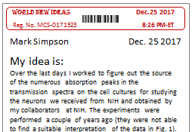
  IF Mark is indeed the FIRST to conceive the idea and he registers it, then
  Mark will be the FIRST to secure physical evidence showing the idea
  (first to have the idea & time-stamp “fixed” in physical form)
  "who is first creator of idea?"
  priority dispute between Mark and Dr. Smith
Evidence brought by Mark:
  Evidence brought by Dr. Smith:
  Testimonial evidence:
  I recall that, in the summer of 2017, I discussed that idea at lunch with Bill … you can ask him
  weak & unreliable
  Prof. Smith cannot bring physical evidence created before Dec. 25, 2017
physical evidence
(time-stamped Dec. 25, 2017)
strong & credible
(physical evidence does not lie)

Slide 17
STEP 2: Priority-Claims for ideas & discoveries
after securing idea priority by Registration
Mark wants to PUBLISH & PROMOTE his IDEA …
  Publishing IDEA in Academic Journals has many deficiencies:
  Journals do not publish EARLY-STAGE IDEAS but require validation by detailed studies (arguments, citations, experiments, data, collaborations, etc.)
  Writing articles takes a LONG TIME, EFFORT and RESOURCES
  Inefficient: Loss of Priority-Time (risk of being scooped), vague message
ALTERNATIVE to Journals:
Publish on our Registry
PRIORITY-CLAIMS for your IDEAS & DISCOVERIES
Quick (2 hours!) … Simple … Efficient

Slide 18
ALTERNATIVE to Journals:
Priority-Claims provide an EFFICIENT way to tell the world:
This is my Idea!
This is my Discovery!
  Mark: “To the best of my knowledge, I am the FIRST to PROPOSE the idea … “
    idea for preventing identity theft …
    explanation re mechanism in cancer cells …
    law for reducing conflicts of interest affecting insurance companies …
Quick (2 hours!) … Simple … Efficient

Slide 19


Registry Publications
… new types of Journals!!
Priority-Claims in Medicine
Sub-field: Neurosciences
Discovery of a new mechanism controlling communication between neurons, by Jonathan Lewis (June 4, 2017).
comments (26) | peer review | rating score: 7
Discovery of a summation phenomenon regarding the effects of subthreshold electric field stimulations in human cortex, by Alice Yu (July 12, 2017)
comments (4) | peer review | rating score: 9
Discovery of a mechanism controlling the communication between neurons by Jonathan Lewis (Aug 13, 2017).
comments (6) | peer review | rating score: 2
Discovery of a new mechanism controlling the communication between neurons, by Lewis (Oct. 21, 2017).
comments (21) | peer review | rating score: 8
An idea for preventing the triggering of protein misfolding disease in brain tissue, by Kathy Cooley (June 4, 2017)
comments (31) | peer review | rating score: 4
Discovery of a new mechanism controlling the communication between neurons, by Lewis (Oct. 21, 2017).
comments (21) | peer review | rating score: 8
Priority-Claims in
Science & Engineering
Sub-filed: Semiconductors
Discovery of a new mechanism controlling communication between neurons, by Jonathan Lewis (June 4, 2017).
comments (26) | peer review | rating score: 7
Discovery of a summation phenomenon regarding the effects of subthreshold electric field stimulations in human cortex, by Alice Yu (July 12, 2017)
comments (4) | peer review | rating score: 9
Discovery of a mechanism controlling the communication between neurons by Jonathan Lewis (Aug 13, 2017).
comments (6) | peer review | rating score: 2
Discovery of a new mechanism controlling the communication between neurons, by Lewis (Oct. 21, 2017).
comments (21) | peer review | rating score: 8
An idea for preventing the triggering of protein misfolding disease in brain tissue, by Kathy Cooley (June 4, 2017)
comments (31) | peer review | rating score: 4
Discovery of a new mechanism controlling the communication
likely to attract lots of viewers!!
(comments … opinions … peer review … rating)

Slide 20

World Registry of New Ideas
  www.worldnewideas.com
This is MY IDEA! ... and I can prove it
Do you have a
New IDEA / DISCOVERY ?
1. REGISTER your IDEAS & DISCOVERIES
2. Publish a PRIORITY-CLAIM
3. Receive a PRIORITY-CERTIFICATE
4. Have your idea RATED & RANKED
Subfield: Neurosciences
Discovery of a new mechanism controlling communication between neurons, by Jonathan Lewis (June 4, 2017).
comments (26) | peer review | rating score: 7
Discovery of a summation phenomenon regarding the effects of subthreshold electric field stimulations in human cortex, by Alice Yu (July 12, 2017)
comments (4) | peer review | rating score: 9
Discovery of a mechanism controlling the communication between neurons by Jonathan Lewis (Aug 13, 2017).
comments (6) | peer review | rating score: 2
Discovery of a new mechanism controlling the communication between neurons, by Lewis (Oct. 21, 2017).
comments (21) | peer review | rating score: 8
An idea for preventing the triggering of protein misfolding disease in brain tissue, by Kathy Cooley (June 4, 2017)
comments (31) | peer review | rating score: 4
Discovery of a new mechanism controlling the communication between neurons, by Lewis (Oct. 21, 2017).
comments (21) | peer review | rating score: 8
Discovery of a new mechanism controlling the communication between neurons, by Lewis (Oct. 21, 2017).
comments (21) | peer review | rating score: 8
Discovery of a subthreshold electric field stimulations in
… 420 more claims
Priority-Claims in Medicine
SUBMIT A PRIORITY-CLAIM
Search Claims:
Registration of Ideas Priority-Claims Priority-Certificates Rating & Ranking Ideas
Publication date
Priority-Claims Registry
VIEW, SEARCH & REVIEW millions of IDEAS & DISCOVERIES
01/20/2016
to present
Keyword
Motor cortex
Biology
Microbiology
Cell Biology
Genetics
Biochemistry
… see more
Physics
Nuclear Physics
Particle Physics
Condensed Matter
… see more
Chemistry
Geology
Mathematics
Information Tech.
Environmental Sc.
Engineering
Medicine
Cardiology
Orthopedics
Neurosciences
Ophthalmology
Physical Therapy
Urology
see more …
Health Services
Health Administration
Health Insurance
Social Sciences
Sociology
Disability Issues
Poverty Issues
see more
Education
Early childhood
Primary School
Higher Education
Economics
Macro-economics
Micro-economics
Commerce & Trade
see more …
Business & Management
Management
Accounting
Taxation
Finance & Investing
Venture capital
Securities Trading
Mutual Funds
Banking
Insurance Services
Home insurance
Business insurance
Health Insurance
Auto insurance
Professional Fields
Hotels & Hospitality
Airlines Service
Property management
Land management
Transportation
Shipping by sea
Accounting
Consulting services
Personal training
Public Relations
Restaurant services
Food Processing
Professional Training
Airplane Pilot Training
Firefighter Training
Police Officer Training
Airport Security
Hazardous Materials
Prison Guard Training
Government & Admin.
Contracting
Procurement
Aviation Policies
Telecommunications
Criminal Justice System
Energy Policy
Law enforcement
Local Governments
Environmental Policy
Federal Trade Commission
Commerce
Diplomacy
Australia
Brazil
China
Columbia
India
Indonesia
Nigeria
Russia
Games & Sports
Chess
Bridge
Football
Soccer
Baseball
Computer Games
History
Anthropology
Archeology
Philosophy
Writing
Music
The Arts
Rating & Scores
Priority-Claim
Discovery of a new mechanism controlling the communication between neurons
Jonathan Lewis
unrated
rated
show claims with
scores between
Publication Date: Aug. 13, 2017
Idea-Creation-Date: Sept. 15, 2014
Claim: I claim priority for the first discovery of the following control mechanism involved in the primary communication between neurons: communication at the interface between two neurons is controlled, in part, by modulating the curvature of the contact surface between the axons and the dendrites. The closer the curvature of …
Detailed Description Registered Docs.
5
to
10
scores (1-10)
Local Govt.
Anaheim
Baltimore
Chicago
Cleveland
Denver
Los Angeles
New York
Seattle
search
Notes:
for example … we see here the List of Priority-Claims posted in the Neurosciences field …
The public, such as scientists and professionals from all over the world, can access, view and review the ideas posted on the Registry

Slide 21
Priority-Claims are SHORT, EXPLICIT & FORMAL statements describing the claimed ideas, discoveries OR achievements
Claims describe the NEW ideas, such as:
an idea for preventing online identity theft …
an explanation for a mechanism in cancer cells …
a law for reducing conflicts of interest affecting insurance companies
Contextual Info & Support (NOT new / claimed)
Data, arguments, background, experiments, citations, importance, role played in certain scientific achievement, etc. [LONG STORY]
claims separate
what is yours from what is NOT yours
NEW IDEAS separated from Contextual Info
claims extract Mark’s idea from the article
Priority-Claim
Discovery of a new mechanism controlling the communication between neurons
Mark Simpson
Publication Date: Nov. 20, 2019
Idea-Creation-Date: Dec. 25, 2017
Claim 1: I claim priority for the first discovery of the following control mechanism involved in the primary communication between neurons: communication at the interface between two neurons is controlled, in part, by modulating the curvature of the contact surface between the axons and the dendrites. The closer the curvature of the axon's head fits and molds on the ends of the dendrite the more electrical contact points and the better conductivity between the axon and dendrite …
Contextual Info & Support [LONG STORY]
Registered Document
> Public Forum
Comment-1
Comment-2
Comment-3
Registered-doc
Journal Article
… see more
> Peer Review
Reciprocal Peer Review
Expert Review ($50)
Review Reports
> Expert Rating & Scores
Predicted value: 7
Creativity: 9
Submit comments
Publication fee
$100 - $200
Notes:
Here is the priority-claim published by Mark … Priority-Claims are SHORT & EXPLICIT statements describing the claimed new ideas, discoveries OR achievements …
For example, one may publish a claim for
An idea on preventing identity theft …
An idea for explaining a molecular mechanism … OR
A law for reducing conflicts of interest
We are using a format which is similar to the patent format … the New Ideas are presented in the CLAIMS … which are physically separated from contextual information … such as arguments, background, and citations …
In a way … the priority-claims are extracting Mark’s idea from the article … such as to separate his idea from ideas which are not his … MARK does not claim CREDIT for ideas & discoveries that may be presented in the contextual info [[show on article]]

Slide 22
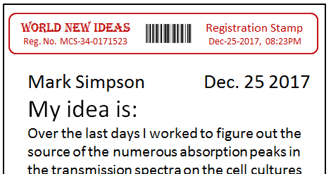
Dec. 25, 2017
Mark conceives & Registers idea
Idea-Creation-Date
Nov. 20, 2019
Mark publishes the idea
Publication Date
Priority-Claim
Discovery of a new mechanism controlling the communication between neurons
Mark Simpson
private (2 years)
Publication Date: Nov. 20, 2019
Idea-Creation-Date: Dec. 25, 2017
Claim 1: I claim priority for the first discovery of the following control mechanism involved in the primary communication between neurons: communication at the interface between two neurons is controlled, in part, by modulating the curvature of the contact surface between the axons and the dendrites. The closer the curvature of the axon's head fits and molds on the ends of the dendrite the more electrical contact points and the better conductivity between the axon and dendrite …
Contextual Info & Support
Registered Document
> Public Forum
Comment-1
Comment-2
Comment-3
Registered-doc
Journal Article
… see more
> Peer Review
Reciprocal Peer Review
Expert Review ($50)
Review Reports
> Expert Rating & Scores
Predicted value: 7
Creativity: 9
public
Submit comments
Mark gets CREDIT for conceiving the idea on the
Idea-Creation-Date
Registry eliminates unsecured time between "idea creation" and "idea publication"
… without rushing the user to publish his ideas or contributions…
Notes:
Now I would like to show you something very special about the priority-claims … as you see here … the priority-claims have a “publication-date” and an “idea-creation-date”
So on Dec. 25th, 2017 Mark conceived and registers his idea … in principle he can publish his idea right away … However, the reality of research environment is that often one cannot publish his idea right away … he needs to wait for the project to be completed, he may risk to upset his advisor, and so on …
With our system, Mark … can keep his idea private for as long as he needs … no matter when he choses to publish (two years later or 5 years later) MARK gets CREDIT for conceiving the idea on the idea-creation-date … (which is within 20 minutes from actual creation) …
the Registered Document, time-stamped December 25th 2017, is displayed on the published claim as proof that Mark created the idea on that date …
Now … Can journal articles include an “idea creation date” like ours? … NOT really …
[[not without priority-claims … the explicit nature of the claims is what makes possible the assignment of an idea creation date]]

Slide 23
TESTING the VALIDITY & VALUE of their ideas & claims:
1. Public Forum & Comments:
2. Reciprocal Peer Review (Free!)
3. Expert Review & Rating ($50)
  4 hours of review by Academics in, e.g., Eastern Europe
4. Formal Examination (Highest Level of Review)
Public Forum
Comment-1
Comment-2
Comment-3
Registered-doc
Journal Article
… see more
Peer Review
Reciprocal Peer Review
Expert Review ($50)
Expert Rating & Scores
Predicted value: 7
Creativity: 9
Formal Examination:
… Similar idea is in the article by Choi & Byron
This is a great idea … it can be used for …
this is not your idea … I heard this from my …
Submit comments
Each person in Neurosciences group has his/her priority-claims reviewed
in exchange for reviewing the priority–claims of someone else
Mark
Mark reviews John’s priority-claims
John
Peter
Peter reviews Mark’s priority-claims
John reviews Peter’s priority-claims
Apply for a
Priority-Certificate
Notes:
By publishing ideas on the Registry innovators get to Test the VALIDITY & VLALUE of their claims
First, peers and experts from all over the world, such as scientists and professionals, can view Mark’s idea and post comments about his claim … For example, someone may comment that a similar idea is disclosed in an article, others may suggest applications for the idea, someone may specifically tell him … “this is not your idea”
In addition, we will provide a couple of Peer Review & Rating options such as “Reciprocal Peer Review” (which is free) and “Expert Review”
At a later stage, we will offer Mark the option to have the claims formally examined

Slide 24
Formal Examination (similar to patent process)
Public Forum
Comment-1
Comment-2
Comment-3
Registered-doc
Journal Article
… see more
Peer Review
Reciprocal Peer Review
Expert Review ($50)
Expert Rating & Scores
Predicted value: 7
Creativity: 9
Formal Examination:
*Priority-Certificates (complex concept / system)
Important REPUTATIONAL BENEFITS for Grantor:
  acting as Academic Authority deciding "what is new and what is not" in scientific world, and Dispute Resolution Authority for scientific disputes
*Non-intrusive forms of IP (ALTERNATIVE to PATENTS - provide only RECOGNITION & PRESTIGE but NO Economic Rights)
Please see Video re Priority-Certificates
Grantors:
Google
LinkedIn
LexisNexis
Stanford
MIT
…
Facebook
Submit comments
Apply for a
Priority-Certificate
*Priority-Certificates, a proposal for non-intrusive forms of IP, Comanescu & Hyndman
Oxford Journal of Intellectual Property, (May 2015)
Notes:
By publishing ideas on the Registry innovators get to Test the VALIDITY & VLALUE of their claims
First, peers and experts from all over the world, such as scientists and professionals, can view Mark’s idea and post comments about his claim … For example, someone may comment that a similar idea is disclosed in an article, others may suggest applications for the idea, someone may specifically tell him … “this is not your idea”
In addition, we will provide a couple of Peer Review & Rating options such as “Reciprocal Peer Review” (which is free) and “Expert Review”
At a later stage, we will offer Mark the option to have the claims formally examined

Slide 25
World Registry of New Ideas
  www.worldnewideas.com
This is MY IDEA! ... and I can prove it
Do you have a
New IDEA / DISCOVERY ?
1. REGISTER your IDEAS & DISCOVERIES
2. Publish a PRIORITY-CLAIM
3. Receive a PRIORITY-CERTIFICATE
4. Have your idea RATED & RANKED
Writing & publishing priority-claims is QUICK and SIMPLE
2 hours! … tell me your idea …
unlike publishing journal articles … which takes lots of TIME, EFFORT & RESOURCES
SUBMIT A PRIORITY-CLAIM
Registration of Ideas Priority-Claims Priority-Certificates Rating & Ranking Ideas
Priority-Claims Registry
VIEW, SEARCH & REVIEW millions of IDEAS & DISCOVERIES
Biology
Microbiology
Cell Biology
Genetics
Biochemistry
… see more
Physics
Nuclear Physics
Particle Physics
Condensed Matter
… see more
Chemistry
Geology
Mathematics
Information Tech.
Environmental Sc.
Engineering
Medicine
Cardiology
Orthopedics
Neurosciences
Ophthalmology
Physical Therapy
Urology
see more …
Health Services
Health Administration
Health Insurance
Social Sciences
Sociology
Disability Issues
Poverty Issues
see more
Education
Early childhood
Primary School
Higher Education
Economics
Macro-economics
Micro-economics
Commerce & Trade
see more …
Business & Management
Management
Accounting
Taxation
Finance & Investing
Venture capital
Securities Trading
Mutual Funds
Banking
Insurance Services
Home insurance
Business insurance
Health Insurance
Auto insurance
Professional Fields
Hotels & Hospitality
Airlines Service
Property management
Land management
Transportation
Shipping by sea
Accounting
Consulting services
Personal training
Public Relations
Restaurant services
Food Processing
Professional Training
Airplane Pilot Training
Firefighter Training
Police Officer Training
Airport Security
Hazardous Materials
Prison Guard Training
Government & Admin.
Contracting
Procurement
Aviation Policies
Telecommunications
Criminal Justice System
Energy Policy
Law enforcement
Local Governments
Environmental Policy
Federal Trade Commission
Commerce
Diplomacy
Australia
Brazil
China
Columbia
India
Indonesia
Nigeria
Russia
Games & Sports
Chess
Bridge
Football
Soccer
Baseball
Computer Games
History
Anthropology
Archeology
Philosophy
Writing
Music
The Arts
Local Govt.
Anaheim
Baltimore
Chicago
Cleveland
Denver
Los Angeles
New York
Seattle
Notes:
The Registry is designed such that … writing & publishing priority-claims is QUICK and EASY … 2 hours! … tell me your idea …
unlike publishing journal articles … which takes lots of time, effort and resources

Slide 26
I. REGISTRY provides a VOICE to
the LESS-INFLUENTIAL innovators of the world
LESS-INFLUENTIAL innovators:
students, interns, young professionals, independents …
in high-potential but developing countries (e.g. India, China, Russia, Romania, Brazil … )
LESS-INFLUENTIAL innovators have major DIFFICULTIES PUBLISHING in Journals (if you don’t have the right credentials … your article is rejected right away …)
REGISTRY … where LESS-INFLUENTIAL innovators can QUICKLY & EASILY publish their ideas
(… ideas are viewed … peer reviewed … promoted)
people have a RIGHT to publish their ideas on the REGISTRY
our RATING & REVIEW system separates the GOOD ideas from BAD ideas
$100 fee keeps away the bogus claims
Notes:
… the REGISTRY provides a VOICE to THE LESS INFLUENTIAL innovators of the world… students, interns, young professionals … and especially to innovators in developing countries such as India, China and Brazil
As well known, the LESS-INFLUENTIAL innovators have major DIFFICULTIES PUBLISHING in Journals … if you do not have the right credentials most journals will reject your article right away …
With us people have a RIGHT to publish their ideas ... as long as your idea is not offensive and you pay the fees … we will publish it … however, our rating & review system separates the GOOD ideas from the BAD ones … whereas the $200 fee will make people think carefully before posting ideas ...

Slide 27
II. using the Registry as a QUICK way to publish EARLY-STAGE IDEAS
  The problem:
  Journals do not publish EARLY-STAGE IDEAS & SINGLE IDEAS but require validation by detailed studies (arguments, citations, experiments, data, collaborations, etc.)
  Writing articles takes a LONG TIME, EFFORT and RESOURCES
  … innovator conceives idea … BUT does not have the TIME to write a full journal article … at that moment idea’s value is uncertain … unclear if worth spending the time & resources to write article … then idea is LOST (lots of good ideas are lost this way)
REGISTRY can be used to QUICKLY (2 hours!) publish:
    ideas for which one does NOT have the TIME to write an article
    ideas which are difficult to publish in journals (e.g. EARLY-STAGE IDEAS & SINGLE IDEAS)
… we are SAVING IDEAS which otherwise would be LOST … and bringing them to society

Slide 28
III. Scientists & innovators can use the REGISTRY to
PROTECT their IDEAS / CONTRIBUTIONS to multi-party Articles / Patents / Projects
    Without the Registry:
    Ideas stays unsecured for 2-3 years
    risk of having idea misappropriated
    risk of being scooped
    risk of aggravating colleagues & advisor
      …
    Contribution of each party?
    Who should be on the ARTICLE?
    Who qualifies as INVENTOR on PATENT?

Slide 29
Without the Registry
“World Registry of New Ideas”
… no unsecured time!
Story of Research Project / Article:
4 years … 15 collaborators … 3 institutions
idea-1: Peter (Oct. 7, 2012)
Feb. 2014
REGISTRATION OF IDEA
Mark uploads idea on Registration-Account
TIME-STAMP applied automatically
(PRIVATE & CONFIDENTIAL)
Idea-Creation-Date: Feb. 5, 2014
idea-2: idea for a novel experiment …
Mark, actual-date: Feb. 5, 2014
20 mins
Experiment: Chen (Aug. 1, 2014)
4 years
2 years
Unsecured Time
…Mark can publish the idea as priority-claim whenever he wants … BUT he waits until the group completes the study and publishes the article.
insight: Vera (Apr. 2, 2015)
Dec. 2016 … 2 years later
idea-9: John (Jan. 3, 2016)
PRIORITY-CLAIM
Mark publishes Priority-Claim for idea
PROMOTES IDEA:
Public Feedback … PEER REVIEW
Idea-Creation-Date: Feb. 5, 2014
Article date: Nov. 8, 2016
10 co-authors:
John, Anne, Mark, Peter, Chen … Bill
Aug. 2020 … 4 years later
Priority-Certificate
Mark applies for & receives certificate
Formal Examination
Idea-Creation-Date: Feb. 5, 2014

Slide 30
Without the Registry
“World Registry of New Ideas”
… no unsecured time!
Story of Research Project / Article:
4 years … 15 collaborators … 3 institutions
idea-1: Peter (Oct. 7, 2012)
Feb. 2014
REGISTRATION OF IDEA
Mark uploads idea on Registration-Account
time-stamp applied automatically
(PRIVATE & CONFIDENTIAL)
Idea-Creation-Date: Feb. 5, 2014
idea-2: idea for a novel experiment …
Mark, actual-date: Feb. 5, 2014
20 mins
Experiment: Chen (Aug. 1, 2014)
4 years
…Mark can publish the idea as priority-claim whenever he wants … BUT he waits until the group completes the study and publishes the article.
2 years
Unsecured Time
insight: Vera (Apr. 2, 2015)
Dec. 2016 … 2 years later
idea-9: John (Jan. 3, 2016)
PRIORITY-CLAIM
Mark publishes Priority-Claim for idea
PROMOTES IDEA:
Public Feedback … PEER REVIEW
Idea-Creation-Date: Feb. 5, 2014
Article date: Nov. 8, 2016
10 co-authors:
John, Anne, Mark, Peter, Chen … Bill
Aug. 2020 … 4 years later
Priority-Certificate
Mark applies for & receives certificate
Formal Examination
Idea-Creation-Date: Feb. 5, 2014

Slide 31



Peter, Mark, Anne, Chen, Vera … John secure
CREDIT for their Individual Ideas & Contributions
Story of Article:
Research Project
4 years … 15 collaborators
Registry
Peter
Oct.7
2012
REGISTRY captures the
Fine-structure
of Journal Articles & Research Projects
insight into the:
Anatomy of the Discovery
Anatomy of
Medical, Technical, & Scientific Achievements
idea-1: Peter (Oct. 7, 2012)
idea-2: Mark (Feb. 5, 2014)
Mark
Feb.5
2014
idea-3: Anne (May. 8, 2014)
Anne
May. 8 2014
experiment: Chen (Aug. 1, 2014)
Chen
Aug.1
2014
4 years
John
Apr. 2 2015
insight: John (Apr. 2, 2015)
Vera
Jan.3
2016
final conclusion & discovery
Vera (Jan. 3, 2016)
Article date: Nov. 8, 2016
DISCOVERY / Achievement
10 co-authors:
John, Anne, Mark, Peter, Chen … Bill

Slide 32
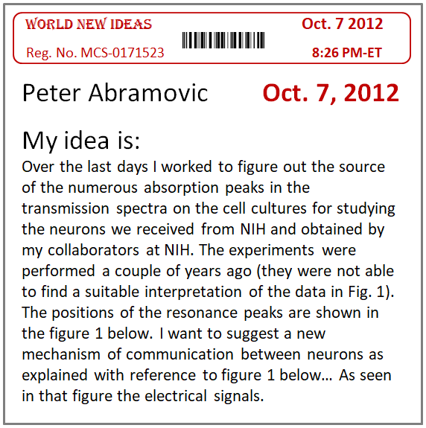
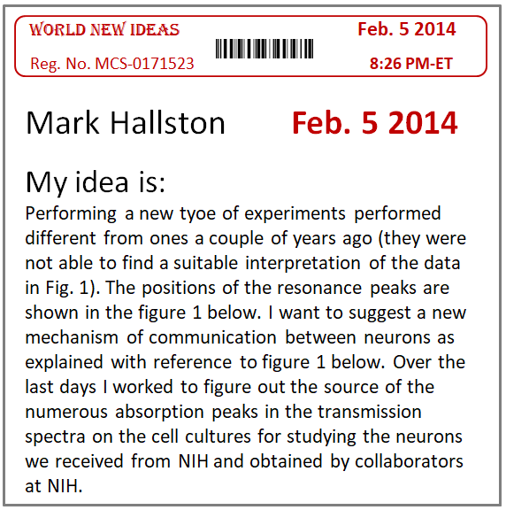
Individual Contributions Citations
Story of Research Project / Article:
4 years … 15 collaborators … 3 institutions
Journal Article
Anne, John, Vera, Mark, Peter, Chen … Bill
Article Received: Nov. 8, 2016
. . . . Body of Article . . . .
. . . . . . . . . . . . . . . . . . . . . . . . . . . . . .
. . . . . . . . . . . . . . . . . . . . . . . . . . . . . .
Citations
. . . . . . . . . . . . . . . . . . . . . . . . . . . . . .
Individual Contribution Citations & Documents
1. Idea for using paired energy levels in stacked QDs.
a. Claimant / Author: Peter Abramovic
b. Relevant article sections: page 3, lines 2-45
c. Idea-Creation-Date: Oct. 7, 2012
d. Support & Priority Documents: Registered Doc
2. Idea for an experiment proving QD entanglement
a. Claimant / Author: Mark Hallston
b. Relevant article sections: page 4, lines 1-26
c. Idea-Creation-Date: Feb 5, 2014
d. Support & Priority Documents: Registered Doc
capturing the “fine-structure” of multi-party articles & projects
idea-1: Peter (Oct. 7, 2012)
idea-2: idea for a novel experiment …
Mark, actual-date: Feb. 5, 2014
Experiment: Chen (Aug. 1, 2014)
4 years
insight: Vera (Apr. 2, 2015)
idea-9: John (Jan. 3, 2016)
Article Received: Nov. 8, 2016
10 co-authors:
John, Anne, Mark, Peter, Chen … Bill
implemented via Publisher
OR
Article / Patent Aggregator
(e.g. Google Scholar)

Slide 33
World Registry of New Ideas
  www.worldnewideas.com
This is MY IDEA! ... and I can prove it
Broad Range of Ideas, Discoveries & Achievements …
  Sciences & Engineering
  Medicine & Health
  Arts & Humanities
  Professional fields
  Government & Admin.
Truly Global Reach … India, China, Brazil, Russia, Nigeria …
Do you have a
New IDEA / DISCOVERY ?
1. REGISTER your IDEAS & DISCOVERIES
2. Publish a PRIORITY-CLAIM
3. Receive a PRIORITY-CERTIFICATE
4. Have your idea RATED & RANKED
SUBMIT A PRIORITY-CLAIM
Registration of Ideas Priority-Claims Priority-Certificates Rating & Ranking Ideas
Priority-Claims Registry
VIEW, SEARCH & REVIEW millions of IDEAS & DISCOVERIES
Biology
Microbiology
Cell Biology
Genetics
Biochemistry
… see more
Physics
Nuclear Physics
Particle Physics
Condensed Matter
… see more
Chemistry
Geology
Mathematics
Information Tech.
Environmental Sc.
Engineering
Medicine
Cardiology
Orthopedics
Neurosciences
Ophthalmology
Physical Therapy
Urology
see more …
Health Services
Health Administration
Health Insurance
Social Sciences
Sociology
Disability Issues
Poverty Issues
see more
Education
Early childhood
Primary School
Higher Education
Economics
Macro-economics
Micro-economics
Commerce & Trade
see more …
Business & Management
Management
Accounting
Taxation
Finance & Investing
Venture capital
Securities Trading
Mutual Funds
Banking
Insurance Services
Home insurance
Business insurance
Health Insurance
Auto insurance
Professional Fields
Hotels & Hospitality
Airlines Service
Property management
Land management
Transportation
Shipping by sea
Accounting
Consulting services
Personal training
Public Relations
Restaurant services
Food Processing
Professional Training
Airplane Pilot Training
Firefighter Training
Police Officer Training
Airport Security
Hazardous Materials
Prison Guard Training
Government & Admin.
Contracting
Procurement
Aviation Policies
Telecommunications
Criminal Justice System
Energy Policy
Law enforcement
Local Governments
Environmental Policy
Federal Trade Commission
Commerce
Diplomacy
Australia
Brazil
China
Columbia
India
Indonesia
Nigeria
Russia
Games & Sports
Chess
Bridge
Football
Soccer
Baseball
Computer Games
History
Anthropology
Archeology
Philosophy
Writing
Music
The Arts
Local Govt.
Anaheim
Baltimore
Chicago
Cleveland
Denver
Los Angeles
New York
Seattle
Notes:
Broad range of ideas … discoveries … and professional achievements in literally all fields …
Many types of ideas …
The sciences and medical fields will probably account for at least 50% … then you have the professional fields … finance (an idea for a legal provision) … insurance … accounting … hotels and hospitality … government and admin … proposal for a law … regulation … solution to a problem … a new chess strategy or move …
The service will lead to the formation of a very valuable asset .. ONE Centralized Database…

Slide 34
World Registry of New Ideas
  www.worldnewideas.com
This is MY IDEA! ... and I can prove it
Registry acts as Massive / Centralized DATABASE
bringing the New Ideas & Discoveries of the World in ONE PLACE
(unlike the 50,000 different journals)
DATABASE is a Valuable Asset
Data Analytics & Data Mining on ideas & discoveries
(provide valuable info for Science, Business, Medicine… )
VALUE of DATABASE is significantly increased by:
  Ideas & Discoveries come ORGANIZED on fields & subfields
  Ideas & Discoveries are FORMATED as Priority-Claims
Do you have a
New IDEA / DISCOVERY ?
1. REGISTER your IDEAS & DISCOVERIES
2. Publish a PRIORITY-CLAIM
3. Receive a PRIORITY-CERTIFICATE
4. Have your idea RATED & RANKED
SUBMIT A PRIORITY-CLAIM
Registration of Ideas Priority-Claims Priority-Certificates Rating & Ranking Ideas
Priority-Claims Registry
VIEW, SEARCH & REVIEW millions of IDEAS & DISCOVERIES
Biology
Microbiology
Cell Biology
Genetics
Biochemistry
… see more
Physics
Nuclear Physics
Particle Physics
Condensed Matter
… see more
Chemistry
Geology
Mathematics
Information Tech.
Environmental Sc.
Engineering
Medicine
Cardiology
Orthopedics
Neurosciences
Ophthalmology
Physical Therapy
Urology
see more …
Health Services
Health Administration
Health Insurance
Social Sciences
Sociology
Disability Issues
Poverty Issues
see more
Education
Early childhood
Primary School
Higher Education
Economics
Macro-economics
Micro-economics
Commerce & Trade
see more …
Business & Management
Management
Accounting
Taxation
Finance & Investing
Venture capital
Securities Trading
Mutual Funds
Banking
Insurance Services
Home insurance
Business insurance
Health Insurance
Auto insurance
Professional Fields
Hotels & Hospitality
Airlines Service
Property management
Land management
Transportation
Shipping by sea
Accounting
Consulting services
Personal training
Public Relations
Restaurant services
Food Processing
Professional Training
Airplane Pilot Training
Firefighter Training
Police Officer Training
Airport Security
Hazardous Materials
Prison Guard Training
Government & Admin.
Contracting
Procurement
Aviation Policies
Telecommunications
Criminal Justice System
Energy Policy
Law enforcement
Local Governments
Environmental Policy
Federal Trade Commission
Commerce
Diplomacy
Australia
Brazil
China
Columbia
India
Indonesia
Nigeria
Russia
Games & Sports
Chess
Bridge
Football
Soccer
Baseball
Computer Games
History
Anthropology
Archeology
Philosophy
Writing
Music
The Arts
Local Govt.
Anaheim
Baltimore
Chicago
Cleveland
Denver
Los Angeles
New York
Seattle
Notes:
Broad range of ideas … discoveries … and professional achievements in literally all fields …
Many types of ideas …
The sciences and medical fields will probably account for at least 50% … then you have the professional fields … finance (an idea for a legal provision) … insurance … accounting … hotels and hospitality … government and admin … proposal for a law … regulation … solution to a problem … a new chess strategy or move …
The service will lead to the formation of a very valuable asset .. ONE Centralized Database…

Slide 35
Ideas & Discoveries expressed as FORMAL Priority-Claims
FORMAT similar to Patent Format:
  NEW ideas described in CLAIMS physically separated from contextual info - arguments, data, background, etc. (unlike journal articles where NEW ideas are buried in 20 pages of contextual info)
  Explicit assertion of Priority: “According to my knowledge, I am the first to ...”
  Claims capture SINGLE ideas & discoveries – (quantum of info)
Language Formalism similar to Patent Claims (without the “crazy” requirements)
FORMATED Ideas & Discoveries are Much Easier to Process via
Artificial Intelligence & Natural Language Algorithms
(compared with ideas & discoveiries in journal articles – mixing new and old info)
improved Data Analytics & Mining
(on new ideas & discoveries of the world - MASSIVE amount of INFO)
Prior-Art Search Engines
Automatic Examination Engines

Slide 36
Networking & Collaboration Platform …
THE VIEWERS
(peers, academic, professionals, investors, clients)
BROWSE / VIEW / SEARCH ideas posted by peers
POST COMMENTS & REVIEW CLAIMS
THE CLAIMANTS
Have their ideas VIEWED, REVIEWED & RATED
DISCUSSIONS, FIND COLLABORATORS, NETWORK
Promote Your Idea …
Discuss …
Find Collaborators …
Network …
List of Priority Claims
Medicine >> Neurosciences
Discovery of a new mechanism controlling the communication between neurons, by Kathy Cooley (June 4, 2015).
comments (26) | peer review | rating score: 7
Discovery of a summation phenomenon regarding the effects of subthreshold electric field stimulations in human cortex, by Alice Yu (July 12, 2015)
comments (4) | peer review | rating score: 9
A new theoretical framework for explaining neural activity distribution in human motor cortex, by Vera Coors (August 13, 2015).
comments (6) | peer review | rating score: 2
Discovery of a new mechanism controlling the communication between neurons, by Jonathan Lewis (Oct. 21, 2015).
comments (21) | peer review | rating score: 8
An idea for preventing the triggering of protein misfolding disease in brain tissue, by Kathy Cooley (June 4, 2015)
comments (31) | peer review | rating score: 4
Discovery of a summation phenomenon regarding the effects of subthreshold electric field stimulations in human cortex, by Alice Yu (July 12, 2015).
comments (24) | peer review | rating score: 7
… 420 more claims
Search Claims:
Publication date
01/20/2016
to present
Keyword
Motor cortex
Rating & Scores
Priority-Claim
Discovery of a mechanism controlling communication between neurons
Jonathan Lewis
unrated
rated
show claims with
scores between
Publication Date: Aug. 13, 2017
Idea-Creation-Date: Sept. 15, 2014
Claim: I claim priority for the first discovery of the following control mechanism involved in the primary communication between neurons: communication at the interface between two neurons is controlled, in part, by modulating the curvature of contact …
Idea Forum
5
to
10
scores (1-10)
search

Slide 37
Business Model Outline
User Fees:
  Registration Accounts – $20 per year (first year free!)
  Publication fees for Priority-Claims – $100 - $200 per priority-claim ($100 for students & low income)
Estimated number of users & viewers (at MATURITY … 10 - 15 years)
    10 – 20 million active Registration Accounts
    5 - 10 million priority-claims filed per year
Estimated Revenue (at MATURITY … 10 - 15 years):
    Registration Accounts: 10-20 million x $20 = $200 - $400 million / year (High Profit Margin)
    Priority-claims: 5-10 million claims x $200 / claim = $1-2 billion / year (High Profit Margin)
  Total Revenue (after 10-15 years): $1 billion - $3 billion / year
Everything is performed automatically via software → High Profit Margin (20%-40%)
please see BUSINESS-MODEL link for detailed explanations
Notes:
At maturity we expect to have 5-10 million priority-claims filed every year … and charge a publication fee of about $200
The corresponding revenue at maturity will be between 2 and 5 billion / year
Similar to service such as LinkedIn or Facebook the questions here is "How to get the first 100,000 users?"
We plan to organize Local then Global "New Ideas Competition" where users submitted ideas as priority-claims

Slide 38
highly desirable features:
ENDURING type of business … 50 YEARS or longer
… similar to Academic Institutions
(in contrast, device based businesses, e.g. Blackberry & Kodak, have short lifespans)
With time, REGISTRY will acquire “Aura” of Academic Authority:
Registry acts as AUTHORITY deciding “what is new and what is not” in the scientific world (similar to US Patent Office … but for non-patentable ideas … via the certificates)
Registry acts as Dispute-Resolution Authority for academic & scientific priority disputes
This “Aura” of Academic Authority can be of value by itself

Slide 39
highly desirable features:
First successful “Idea Registry” likely to become DOMINANT
over the entire WORLD … for many years
  Registry acts as Social Network:
    Unlikely to have many co-existing / competing "Idea Registries":
      Registry-1 (of Company-1) – 5,000,000 claims posted - most of your peers and competitors posted here and look at this Registry → you will want to post here
      Registry-2 (of Company-2) – 1,000 claims - no incentive to post idea where nobody sees it!!
    Economic forces similar to the ones causing Facebook to be the dominant social network (scientists want to post their ideas on the largest & most prestigious Idea Registry because there ideas get the most exposure - most likely to be seen by their peers).
  First to implement “Idea Registry” → Great Competitive Advantage

Slide 40
highly desirable features:
Civic Impact on a Truly Global Scale
The Registry is about:
  … giving a VOICE to the LESS-INFLUENTIAL innovators of the world
  … giving CREDIT where CREDIT is DUE
  … bringing to society ideas & discoveries which otherwise would be LOST
  … FAIRNESS and EQUITY in research & innovation

Slide 41
highly desirable features:
  Small investment → potentially VERY LARGE financial return
  Inexpensive to Run & Implement (everything performed automatically!)
  Priority-Certificates implemented 3-5 years later
  Registry can AID & COMPLEMENT many services:
    Google + (i.e. Registration Accounts)
    Google Scholar
    Google Patents
    Google’s Education Packages

Slide 42
How to get the first 100,000 users?
Customer acquisition via “New Ideas Competition”
  Organizing local / global “New Ideas Competitions”
    participants will submit ideas as priority-claims via our REGISTRY (i.e. open Registration Accounts … and file claims for the new ideas)
    prizes will act as incentive for attracting users & claim submissions
  New Idea Competition in DC-Baltimore region (e.g. partner with MD/VA entrepreneurship events via TEDCO, CIT, MD Tech Council, CONNECTpreneur, MIT Enterprise, DC Wharton Club)
    50 prizes over 20 fields
    (20 prizes x $10,000) + (30 prizes x $5,000) = $350,000
  Once Registry reaches 100,000 users → likely to snowball
  Partnering with major IT company (e.g. Google, Facebook, LinkedIn …)

Slide 43
CURRENT STATUS
Core concepts priority-certificates, priority-claims & idea registration disclosed:
  Oxford Journal of Intellectual Property (Comanescu & Hyndman, June 2015)
  Intellectual Property Today (Comanescu et. al, March 2014)
PATENT APPLICATIONS filed in USA, Canada, India, Australia …
System has been reviewed by more than 30 prestigious scientists & academics
Prototype & alfa-testing of software package
    “Model” website: www.worldnewideas.com
    Prototype of web-service: www.world-new-ideas.com
Jerry Comanescu, Ph.D.-Esq.
comanescu68@gmail.com; tel: 202-754-2064

Slide 44
OUR TEAM
Jerry Comanescu, Ph.D.-Esq. – a physicist and IP attorney. His experience includes 10 years as physicist in various R&D institutions such as General Electric and Naval Research Laboratory in DC. He is currently managing the physical sciences IP portfolio of The George Washington University.
Teodor Tecsa, Ph.D. - a senior software development manager with more than 25 years of IT experience with IBM and other IT companies. Teodor has first hand experience with internet start-ups where he had a significant role in growing e-Commerce start-up company from 3 to over 80 employees.
Bogdan Neculaes, Ph.D. – an experienced technology portfolio leader and physicist. Bogdan leads the research and development portfolios for X-Ray generation and Bioelectrics at General Electric Co. His experience includes working with high tech start-up companies and venture capital firms.
Debbie Lin-Teodorescu, MD - founder & CEO of SurgiBox Inc., an exciting MIT/Harvard startup company that has won numerous prizes, such as the HARVARD President’s Challenge Competition. She holds an MD degree from Harvard Medical School.
Horia Mike Teodorescu, Ph.D. - Harvard Business SCHOOL, currently faculty at Boston Collge Business School, Mike is a former software engineer with Microsoft. He received a degree in computer science from Harvard.
Alex D. Luta – Alex is the former CEO of Innovo Consulting, a nonprofit group of college students that provides consulting services to social entrepreneurs/innovators and other nonprofits.
Lex McCusker, Ph.D. – former CEO of AT&T text-to-speech startup Natural-Voices. Between 2006 and 2009 Lex was the Dean of the School of Technology Management at Stevens Institute of Technology. Director of Student Entrepreneurship Programs at The George Washington University and the President of the Dartmouth Entrepreneurial Network of DC.
www.worldnewideas.com
Jerry Comanescu, Ph.D.-Esq. | comanescu68@gmail.com | tel: 202-754-2064

